Slide 1
Energy saving way in Mobile BSL3 Lab
28/8/2019/, 8/3/2020
Miki Hideki

Slide 2
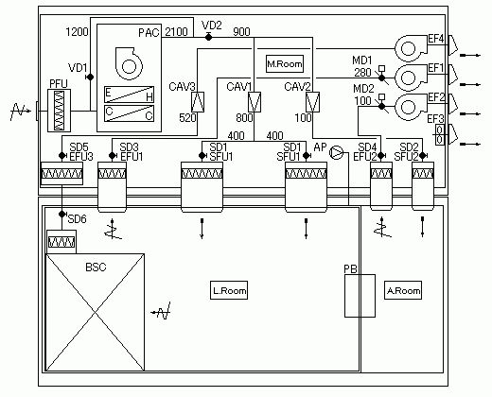
Air conditioning system
Note)
PFU: Pre (Rough & Medium efficiency) Filter Unit
SFU: Supply (HEPA) Filter Unit
EFU: Exhaust (HEPA) Filter Unit
PAC: Packaged Air Conditioner
EF: Exhaust Fan
CAV: Constant Air Volume unit
MD: Motor Damper
SD: Shut off Damper
VD: Volume Damper
AP: Air Pump
BSC: Bio Safety Cabinet
PB: Pass Box

Slide 3
Air conditioning energy consumption
Sign | Name | Source | Energy consumption | Note
PAC | Air conditioner | 3Phase, 200V | 4.6kW (compressor), 1.5kW (indoor fan), 0.38kW (outdoor fan)
EF1 | Fan | 3Phase, 200V | 0.75kW
EF2 | Fan | 1Phase, 100V | 0.1kW
EF3 | Fan (Ventilator) | 1Phase, 100V | 0.05kW
EF4 | Fan | 3Phase, 200V | 0.75kW
BSC | Bio safety cabinet | 1Phase, 100V | 0.3kW (fan)
Other | Controller | 1Phase, 100V | 0.2kW
Total |  |  | 8.63kW
Except lighting fixture, experimental equipment and others.

Slide 4
Air conditioning Control
If the air filters are not clogged, the supply air volume to lab room and anteroom is constant due to CAV1 and CAV2.
Also the room pressure of lab room and anteroom is constant due to MD1 and MD2.

Slide 5
Energy Saving by stopping BSC
If stopping BSC, the supply air volume and room pressure will be constant.
If stopping BSC, energy saving amount is 0.3kW (BSC fan), and energy saving ratio is 0.3 / 8.63 = 3%.
If stopping BSC and EF4, energy saving amount is 0.3 (BSC) + 1.5 (fan) = 1.8kW, and energy saving ratio is 1.8 / 8.63 = 21%.

Slide 6
Energy Saving by other way (1/2)
If you want to reduce more energy consumption, I recommend 2 ways.
One is to stop cooling by the air conditioner panel.
If so, the air conditioner runs for only supplying air.
If stopping cooling. energy saving amount is 4.6 (compressor) + 0.38 (outdoor unit fan) = 4.98kW, and energy saving ratio is 4.98 / 8.63 = 58%.
But this way has the risk of breaking the freezer due to the high room temperature, so try carefully.
Instead of stopping cooling, setting temperature point higher is also effective.
This way needs no money.

Slide 7
Energy Saving by other way (2/2)
If you want to reduce the energy consumption, I recommend 2 ways.
Another is to improve the air conditioning system in order to reduce the supply air volume in case of BSC stopping.
But the present control system cannot reduce the supply air volume.
If using inverter instead of CAV and MD, you may can.
This way needs large money and time.

Slide 8
End
Cost performance ratio is important.

